Slide 1
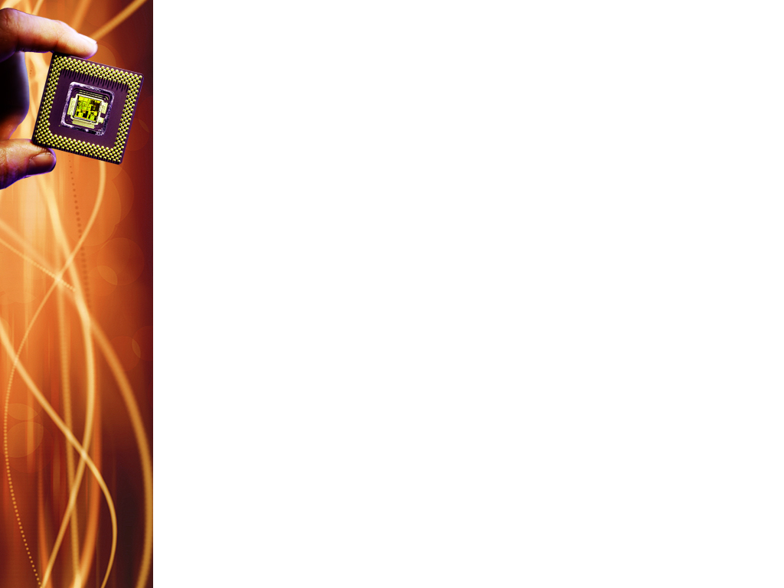
Universal Verification Component (UVC)
Components
Driver
Monitor
Gets transactions from sequencer: get_next_item(item)
Drives transactions on the DUT interface: send_to_dut(item)
Indicates to the sequencer that it is done: item_done()
Connects to the DUT via a SV virtual interface
Collects information from the DUT
Contains events, status, checkers & coverage
Monitor is independent of driver
Agent
Contains instances of sequencer, driver & monitor
Configurable: is_active flag indicates whether agent is active or passive
Is_active == 1 – all agent components constructed
Is_active == 0 – only monitor
Sequencer
Controls generation of stimulus
Upon request from driver, generates sequences of transactions

Slide 2
UVM Monitor
What is a monitor?
A UVM component that captures signal activity from design interface and translates it into transaction level objects that is sent to other components.
What does it require?
A virtual interface handle to the actual interface that the monitor is monitoring.
TLM Analysis port declarations to broadcast captured data to others.

Slide 3
UVM Monitor
What does UVM Monitor do?
Collect bus or signal information through a virtual interface.
Collected data can be used for protocol checking and coverage (enable/disable with knobs).
Collected data is exported via an analysis port.
Notes:
The UVM monitor functionality should be limited to basic monitoring. It may have knobs to enable/disable basic protocol checking and coverage collection. High level functional checking should be done outside the monitor, in a scoreboard.

Slide 4
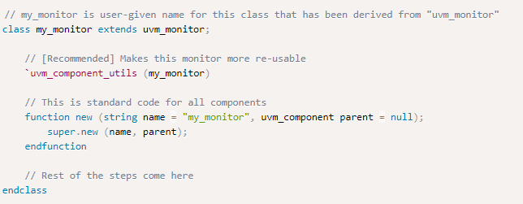
Step-1 to create UVM monitor
Create custom class inherited from uvm_monitor, register with factory and call new.

Slide 5
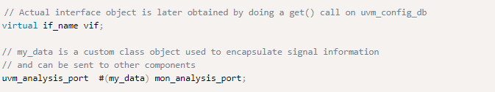
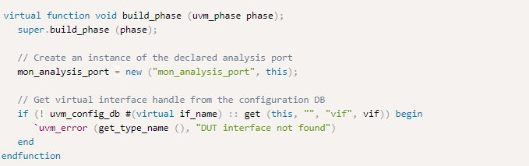
Step-2 to create UVM monitor
Declare analysis ports and virtual interface handles
Step-3 to create UVM monitor
Build the UVM monitor

Slide 6
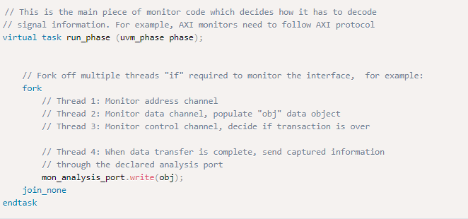
Step-4 to create UVM monitor
Code the run_phase
Notes:
A fork..join_none allows the main thread to resume execution of further statements after the fork, regardless of whether the forked threads finish. If four threads are launched, the main thread will resume execution immediately while all four threads run in the background.
After the sampling logic in the run_phase, the sampled transaction packet is sent to the scoreboard by using the write method.

Slide 7
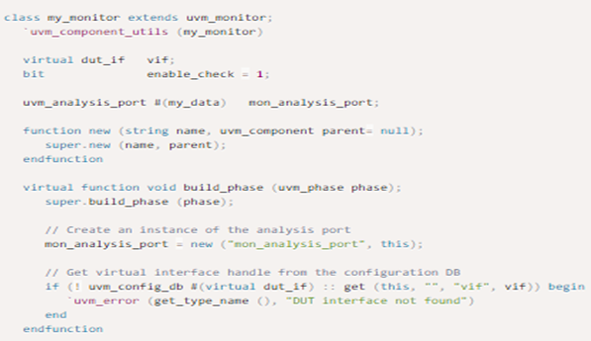
Notes:
In this example of a UVM monitor:
Monitor is extended from uvm_monitor
Virtual interface handle is declared as vif and assigned from UVM database via uvm_config_db::get()
Additional knobs are provided for enabling/disabling protocol checker (enable_check) and coverage (enable_coverage)
Coverage group defined as cg_trans will be sampled during run phase
During run_phase(), data from interface is captured into local class object, protocol check is performed when enable, and coverage group is sampled when enabled.
Data object class is broadcast to other verification components via the analysis port.

Slide 8
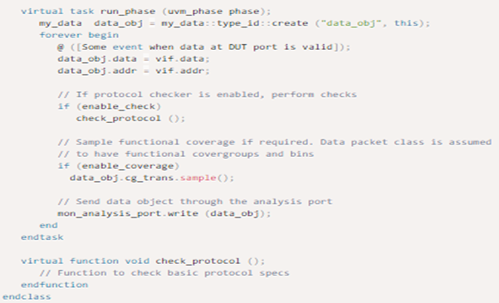
Notes:
Additional knobs are provided for enabling/disabling protocol checker (enable_check) and coverage (enable_coverage)
Coverage group defined as cg_trans will be sampled during run phase
During run_phase(), data from interface is captured into local class object, protocol check is performed when enable, and coverage group is sampled when enabled.
Data object class is broadcast to other verification components via the analysis port.

Slide 9
Knobs in UVM Monitor
The knobs can be disabled from the test by using the UVM database.

Slide 10
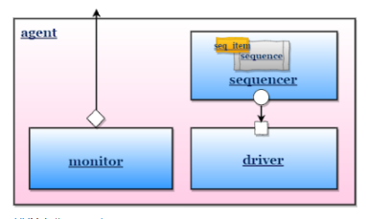
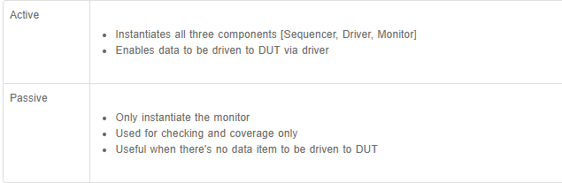
UVM Agent
The set config can be done in the env or test.
Notes:
An agent encapsulates a sequencer, driver, and monitor into a single entity by instantiating and connecting the components together via TLM interfaces. The agent can also have configuration options like the type of UVM agent (active/passive), knobs to turn on features such as functional coverage, and other similar parameters.
The agent can be configured as active/passive by using a set config method, the default agent will be ACTIVE. The set config can be done in the env or test.

Slide 11
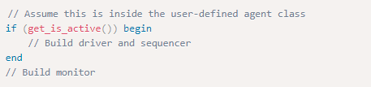
UVM Agent – Active or Passive?
get_is_active() – returns the state of the requested UVM agent
Notes:
get_is_active() returns UVM_ACTIVE if the agent is active and UVM_PASSIVE if the agent is passive. This is a macro available in uvm_agent and user-defined agent classes derived from uvm_agent.

Slide 12
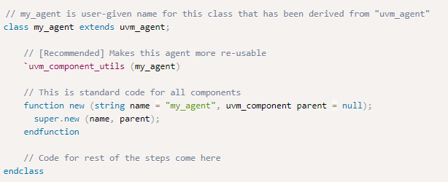
Creating a UVM Agent
Create a custom class inherited from uvm_agent, register with factory and call new.

Slide 13
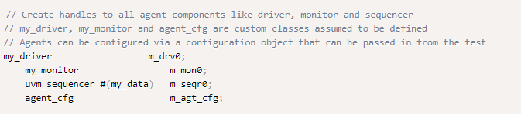
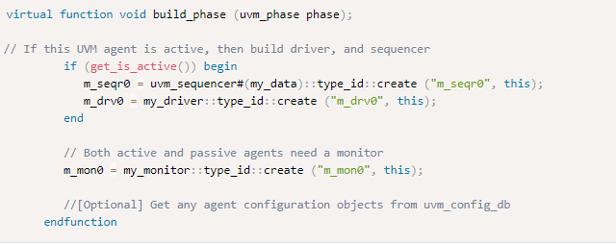
Creating a UVM Agent
2. Instantiate agent components
3. Instantiate and build components

Slide 14
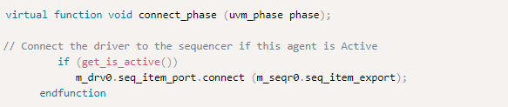
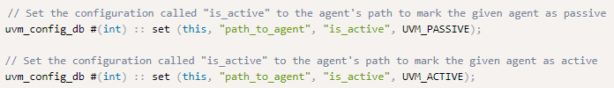
Creating a UVM Agent
4. Connect agent component together
How to configure UVM agent as active or passive?
Notes:
The is_active variable of the user defined agent derived from uvm_agent, which is of enum type uvm_active_passive_enum is used to configure the UVM agent as active or passive. By default, all agents are active.

Slide 15
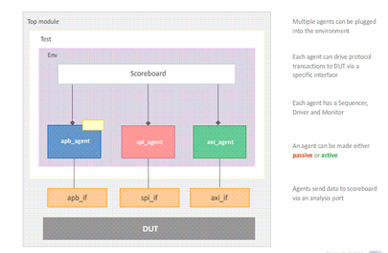
What does UVM agent do?
Provides protocol specific tasks to generate transactions, check the results and perform coverage.
Notes:
The sequencer in a UVM agent will generate data items that can be sent to the driver. The driver then converts the data item class object into actual pin level signals and drive them to the DUT. The monitor may passively collect the outputs from the DUT, convert them back into another data item class object and distribute it among all other components in the testbench waiting for the item.
Each agent should have a configuration object that will contain a reference to the virtual interface that can be used by its driver and monitor to access pin level signals. This object can also contain other data members which will control which of the agents sub-components are built and it may also contain information that affects the behavior of the agents components. Some other functionalities that can be included are:
Functional coverage monitor to collect protocol information
Scoreboard if required to check protocol data
API sequences that might be useful for implementing an API layer.

Slide 16
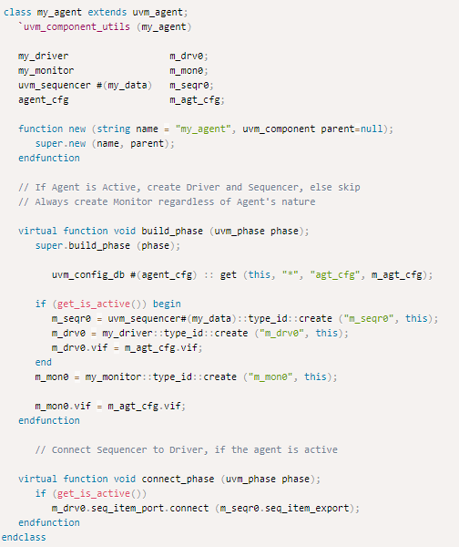
Notes:
An agent should be derived from the uvm_agent.
Since agent is a component, it is registered with the factory using `uvm_component_utils
Instantiations m_seqr0, m_drv0, m_mon0 are sequencer, driver, and monitor respectively.
Uvm_active_passive_enum is a UVM enum declaration that stores UVM_ACTIVE or UVM_PASSIVE
In the build_phase(), sequencer and driver are created only if the agent is configured to be active. The variable is_active is set either at environment level or via a configuration object retrieved from the resource database.
Similarly, connection between sequencer and driver needs to be done only if they were built during the build phase.

